Slide 1
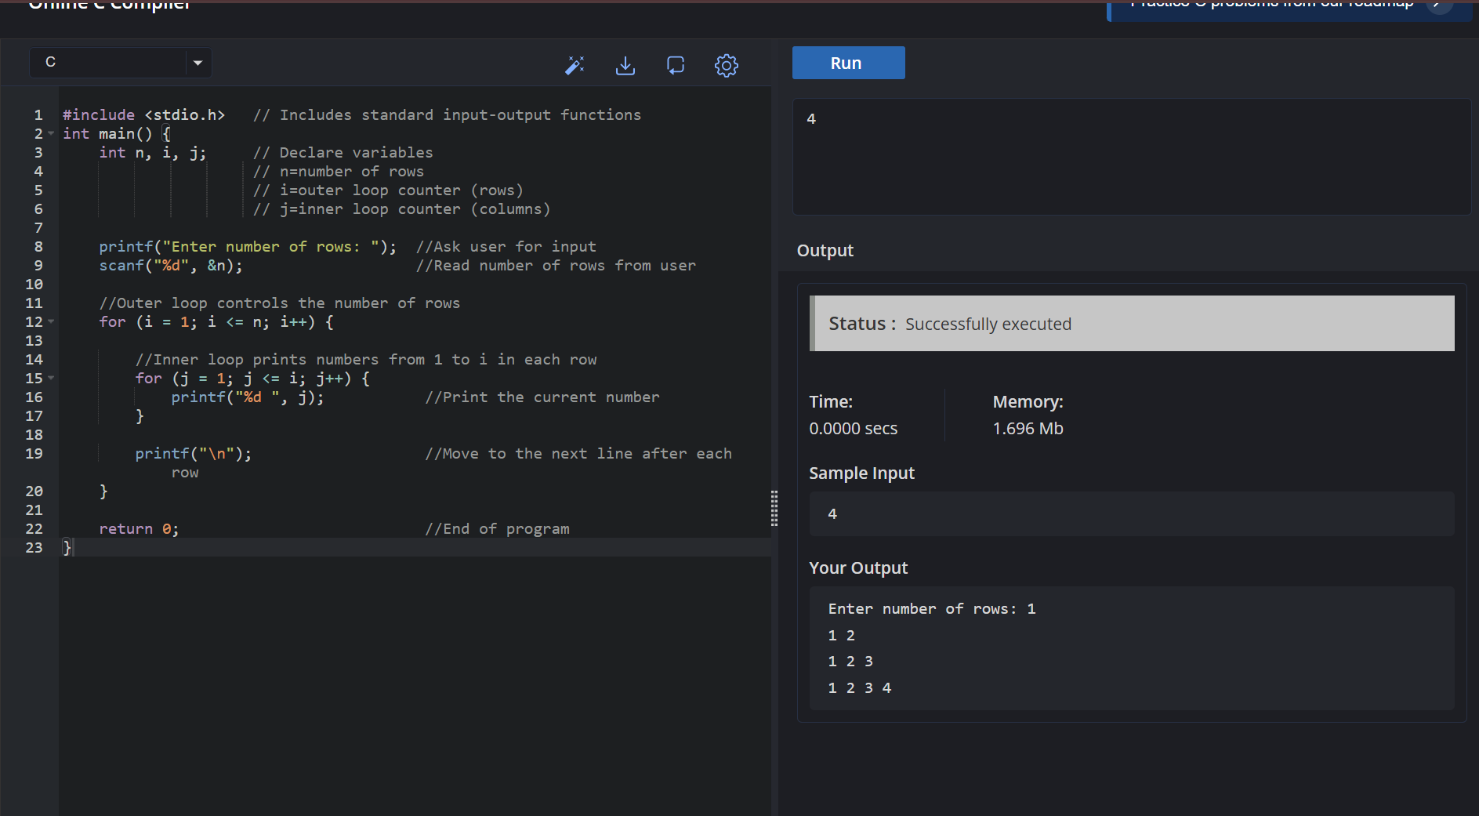
Output test cases

Slide 2
